Slide 1
12 min
Canopy – AI initiative

Slide 2
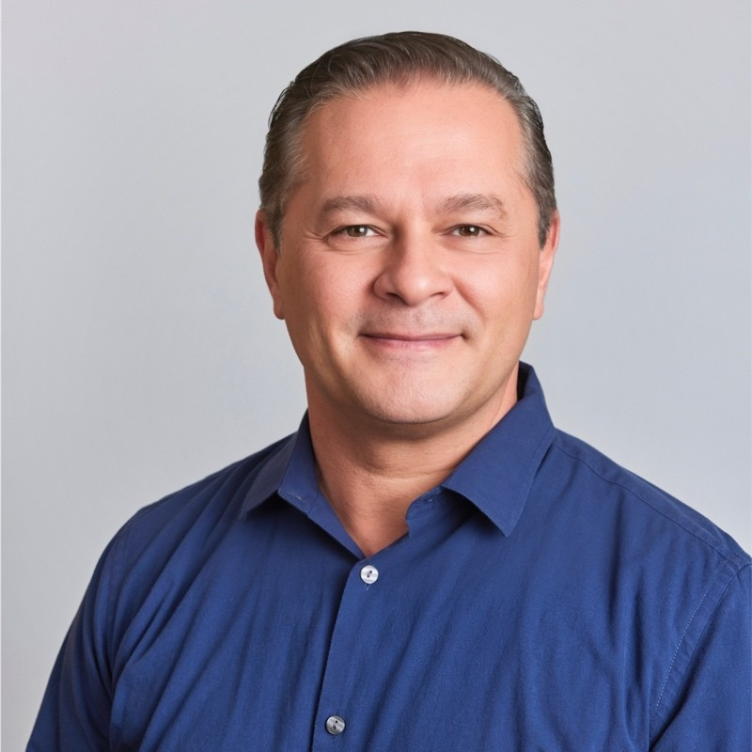

  AI & Canopy
  Leveraging AI as an agent to participate in the process through data research, analysis, & content creation
Franco Ruggeri
Head of Product, Transform
Board product member, Canopy
Inputs
Logic
Output
A simplified framework for building AI products
Structured data & clear signals
Meaningful and automatable actions
Repeatable decision patterns

Slide 3
  SemperVirens Accelerator
The SVA workflow
Inputs
Logic
Output
Inputs submitted through Typeform
Sync with spreadsheet
Match for thesis?
Valid distribution channels?
Accelerator fit?
AI memos
Emails to finalists
Voting for selections

Slide 4
  How can AI help??
The SVA workflow
Inputs
Logic
Output
Extraction of all data from submission forms
Accelerator program FAQs
Market Maps
Scoring mechanisms
An interactive experience to facilitate evaluation
AI Extraction Service
AI Analysis Service
AI Website Creation Service

Slide 5
  Demo
Launch Demo

